Slide 1
SBIRT Workflow Development & Best Practices
Nevada Health Center
August 2020

Slide 2
Agenda
Welcome, Introductions
Workflow best practices
Screening
Brief Intervention
Referral & Follow up
Organizational Sustainability & Next steps
Notes:
Develop a protocol to including required screenings and interventions, referrals, documentation, invoicing, & follow-up. Also, procedures for continual monitoring of processes, outcomes, and costs.
Develop workflows, quality improvement processes, and operating systems to implement SBIRT successfully.
Integrate SBIRT protocols with existing P&P so that SBIRT becomes an integral part of service delivery, not an add-on service.
Gain sustainability practices to make SBIRT a routine part of health care delivery.
Prepare for ongoing training and development, including on-boarding new staff, evidence updates, etc.

Slide 3
Jennifer Trujillo
Nevada Primary Care Association
Pam Pietruszewski & Aaron Williams
National Council for Behavioral Health
Danielle Kajdic
Community Health Care, Inc.
Danica Pierce & Amanda Prina
Northern Nevada Hopes

Slide 4
SBIRT Process
Screening
No Use or
Low Use
Moderate
Use
High
Use
Reinforce
healthy
choices
Brief Intervention
Referral to Treatment
Follow-up

Slide 6
Why is SBIRT so important?
5% of the population suffers from addiction to alcohol or another mood-altering chemical.
5%
20%
20% participate in “risky use” often from lack of education.
SBIRT
75% are abstinent or use within the recommended limits.
75%

Slide 7
Workforce Considerations
Providers
Front Desk Staff
Care Coordination Assistants
Behavioral Health Specialists/ Social Workers
RNs
Community Partners
Medical Assistants

Slide 8
Screening Tools:
Annual Questionnaire

Slide 9
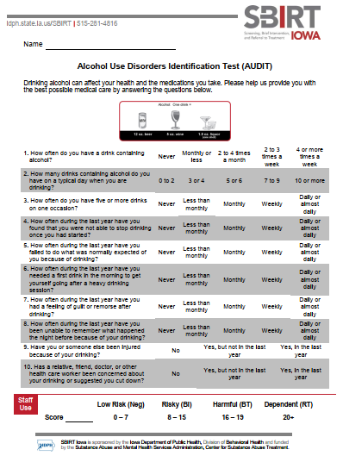
Screening Tools: AUDIT

Slide 10
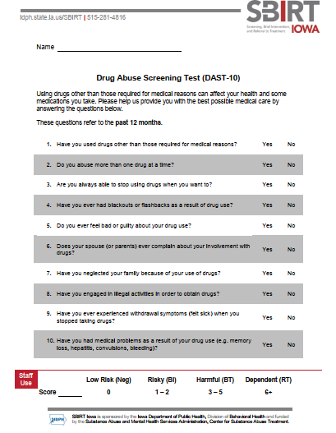
Screening Tools: DAST

Slide 12
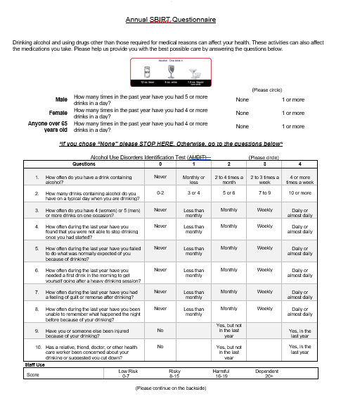
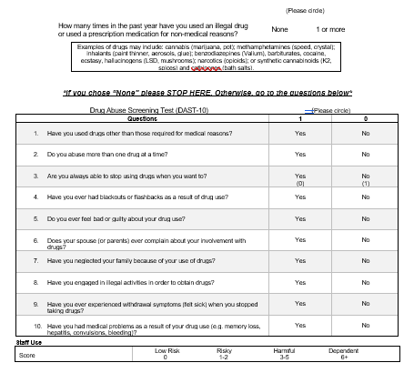
Annual SBIRT Questionnaire: Prescreen, AUDIT, and DAST combined on one form

Slide 13
Questions, Comments, Discussion

Slide 14
Now What?
Chart Prep
Identify patients who need to complete SBIRT screening
Adults 18 years and older
New patients
Screenings completed every 12 months
Pre-screen (Electronic or Paper Copy)
2 questions to identify risk
AUDIT/DAST (Electronic or Paper Copy)
Alcohol Use Disorders Identification Test
10 questions to assess alcohol use in more detail
Drug Abuse Screening Test
10 questions to assess drug use in more detail
Recommendations
Encouragement and praise
Brief Intervention
Brief Treatment
Referral to Treatment

Slide 15
Data from 2012-2017 (CHC)

Slide 16
Questions, Comments, Discussion

Slide 17
Workflow #1 (Paper Copy)
SBIRT Date documented in medical record and form scanned into chart
Identify patients needing SBIRT screen (Front Desk, Nursing Staff, Behavioral Health Team)
Negative
Nursing staff completes Pre-screen with patient
Behavioral Health Team Member completes AUDIT and/or DAST, provides appropriate intervention and makes referral as needed
Nursing contacts member of Behavioral Health Team
Positive

Slide 18
Workflow #2 (Paper Copy)
SBIRT Date documented in medical record and form scanned into chart
Identify patients needing SBIRT screen (Front Desk, Nursing Staff, Behavioral Health Team)
Negative
Patient fills out pre-screen form during check-in
Nursing staff collects form when patient is roomed
Behavioral Health Team Member completes AUDIT and/or DAST, provides appropriate intervention and schedules with BH Provider or makes referral as needed
Positive
Nursing contacts member of Behavioral Health Team

Slide 19
Workflow #3 (Paper Copy-combined form)
SBIRT Date documented in medical record and form scanned into chart
Identify patients needing SBIRT screen (Front Desk, Nursing Staff, Behavioral Health Team)
Patient fills out Pre-Screen, AUDIT and/or DAST form during check-in
Negative
Nursing staff collects form when patient is roomed and adds up score, if applicable
Behavioral Health Team Member or RN provides appropriate intervention and schedules with BH Provider or makes referral as needed
Nursing staff contacts Behavioral Health Team Member or RN
Positive

Slide 20
Workflow #4 Telehealth (Electronic Form)
During check in process, Nursing Staff completes pre-screen, AUDIT and/or DAST with patient (Electronic form completed in medical record)
No further intervention is needed.
Negative (or Low Risk)
Behavioral Health Team Member signs onto telehealth platform to meet with patient after PCP is finished with visit. BHTM provides appropriate intervention and schedules with BH Provider or makes referral as needed.
Positive and patient agrees to meet with a member of the Behavioral health Team
Nursing staff contacts member of Behavioral Health Team to provide “virtual warm handoff”

Slide 21
Questions, Comments, Discussion

Slide 22
SBIRT in VERY FLEXIBLE. Do what works for you and your team!

Slide 23
Patient Education

Slide 24
Organizational Sustainability
A
P
Leadership support
Identifying champions
Time and resources
Expectations for targets
Quality improvement plan
Piloting
Assessing data and refining workflows
Rollout to full practice
Training, onboarding, supervision
Data
S
D
D
P
A
A
S
P
D
A
P
S
D
Learning & Improvement

Slide 25
Developing an Operational Plan for SBIRT
1. Workflow: Staff roles & tasks, target population, process
2. Screening: Tools, frequency, delivery method
3. Brief intervention: Scripting, practicing, resources
4. Referral and follow up: Warm hand off process, internal vs external resources
5. Record keeping: Documentation, risk stratification, information flow
6. Training & supervision: Core competencies, onboarding

Slide 26
SBIRT Care Pathway
What is our SBIRT policy & procedures?
Target population for screening and intervention
Screening frequency
Purpose of intervention
Defines screening instruments
Defines appropriate clinical responses
Incorporates SBIRT into EHR
Identifies staff roles and responsibilities
Notes:
For improved care coordination through SBIRT, the clinical pathway or protocol for SBIRT practice needs to be defined. This includes:
Workflow Redesign
Visualizing and mapping the Current vs. desired future state
Maximize efficiencies within the organization and its partnerships
Clinical responses: There are different strategies to fitting this into clinical workflow, as long as you operate in fidelity to the SBIRT protocol and cover all pieces. Each strategy has implications for flow, warm hand off, transfer of data, especially for those who use more swimlanes.
Mapping out EHR role: Another part of clinical workflow is clinical decision support in EHR. How are you going to work on EHR optimization? Are screening forms in your EHR? Must you implement workarounds to ensure that records and data are of high quality?
Clinical guidelines identify staff roles and responsibilities (Champion and Change Team), as well as reimbursement rates.
These guidelines should hold strong even in the case of changes to leadership and staff.

Slide 27
Build your SBIRT business model into your clinical workflow
Do not depend on individual staff to exercise clinical judgment & remember / decide when to do SBIRT.
Initial screening: Delegate to least expensive staff permissible
Research what screening code the payer covers and how often it can be billed
Research minimum required credentials for performing the screening
Your biggest revenue opportunity will be high-volume initial screening
Brief interventions: Research available brief intervention codes
Independently licensed clinicians are likely to use a different code than other qualified staff
Research billing separately vs. bundling SBIRT into E&M and up coding due to additional time

Slide 28
Q&A Next Steps

